Slide 1
Program
MineOperate Technical Level 1
Support Process
Edgar Sepulveda
Global Technical Manager, MineOperate
10/10/2022
Version 1.3

Slide 2

Purpose
This session …
​At the end of this module, you will:

Slide 3
Support Process
Support tickets process
Create a Salesforce ticket
Troubleshoot
Need help?
Escalate it to GT
Troubleshoot
Bug?
Escalate it to PD
Yes
Yes
No
No
Support
Close
ticket

Slide 4
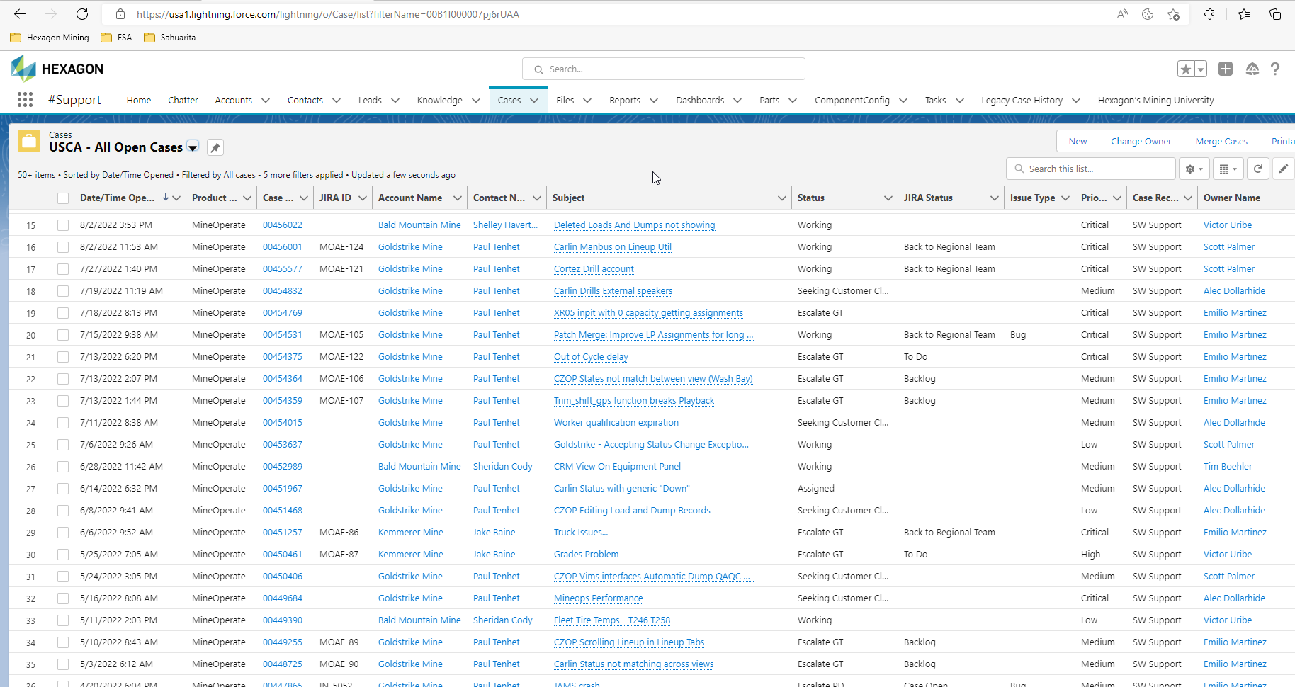
Support Process
Create a Salesforce software support ticket

Slide 5
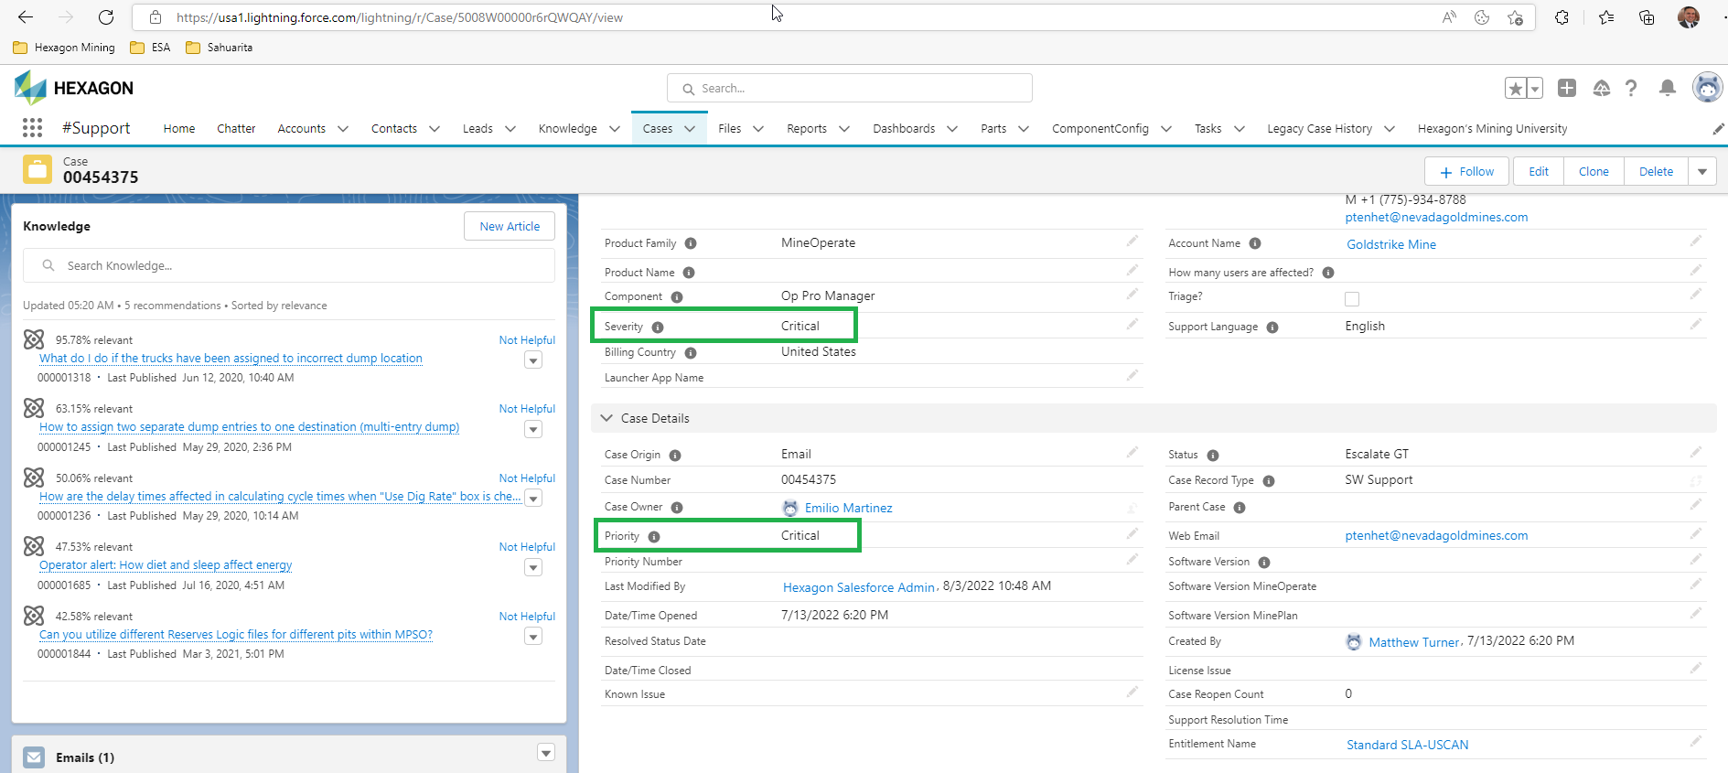
Support Process
Assign Severity and Priority to ticket

Slide 6
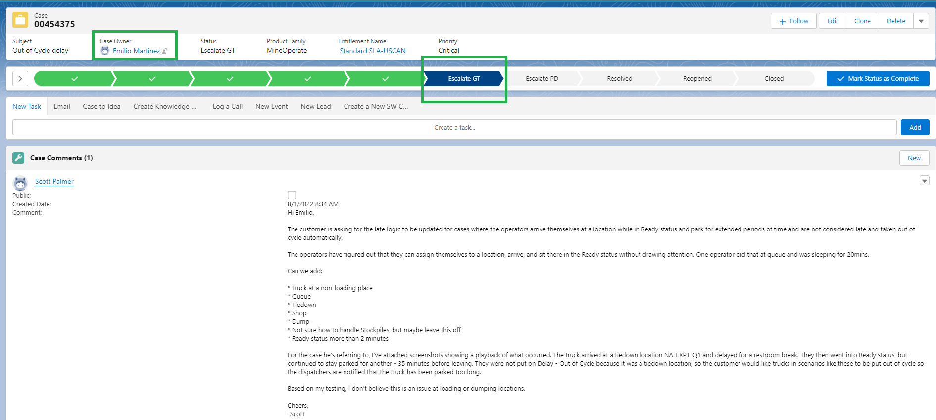
Support Process
Escalate ticket to Global Team

Slide 7
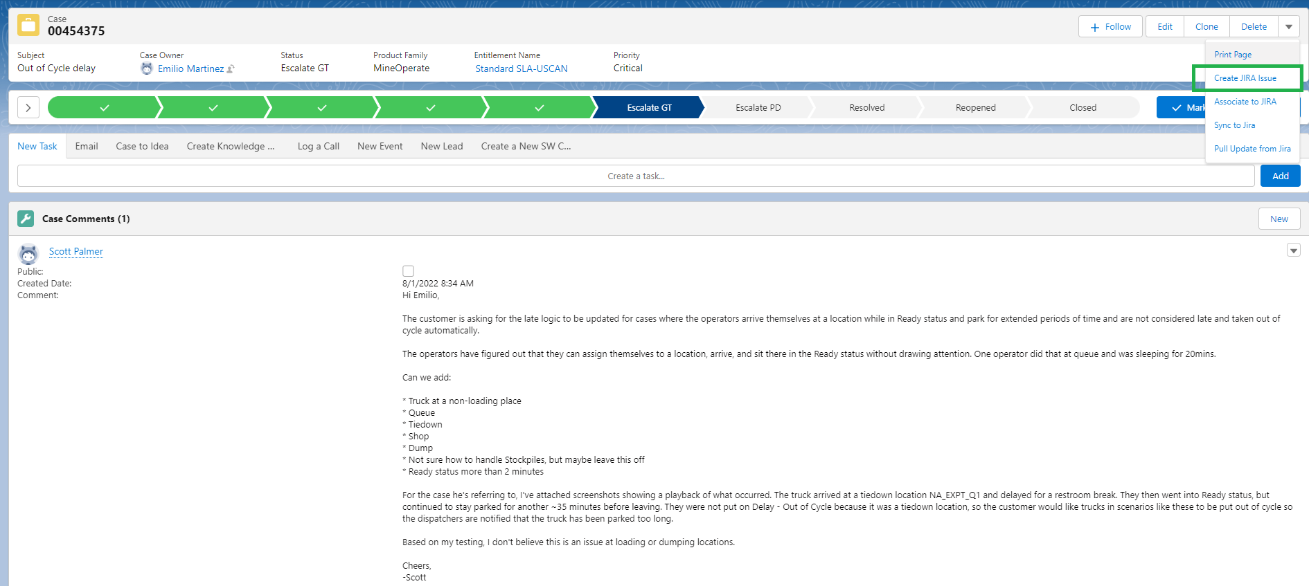
Support Process
Create a JIRA ticket for the Salesforce ticket

Slide 8
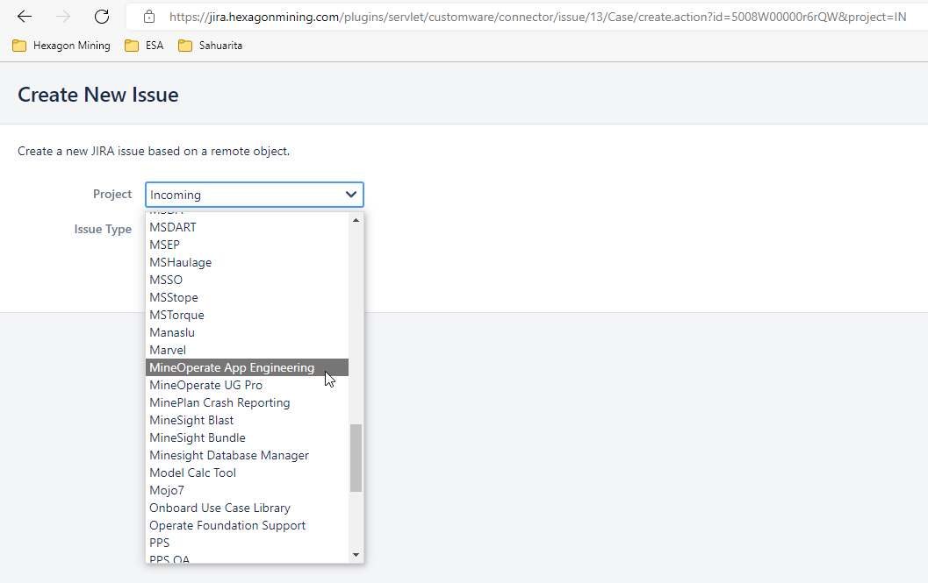
Support Process
Select MineOperate App Engineering project

Slide 9
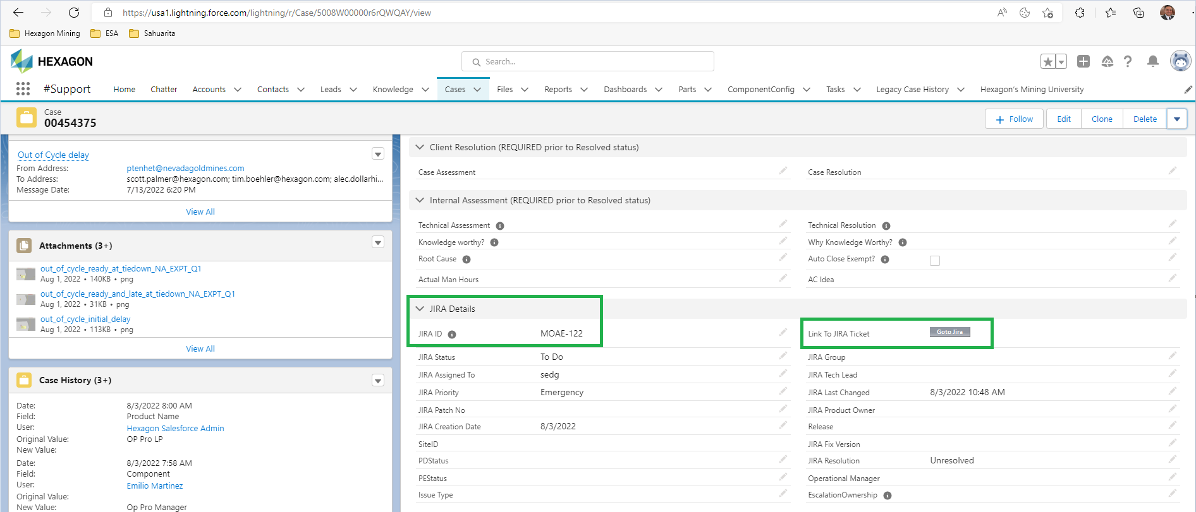
Support Process
Check that JIRA Details were populated in the Salesforce ticket

Slide 10
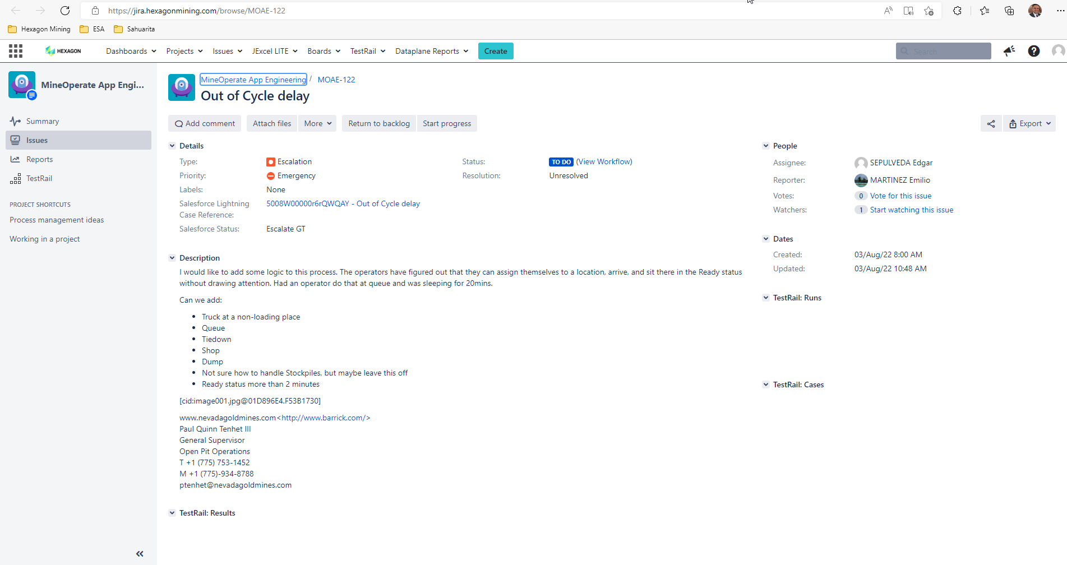
Support Process
Check JIRA tikcket

Slide 11
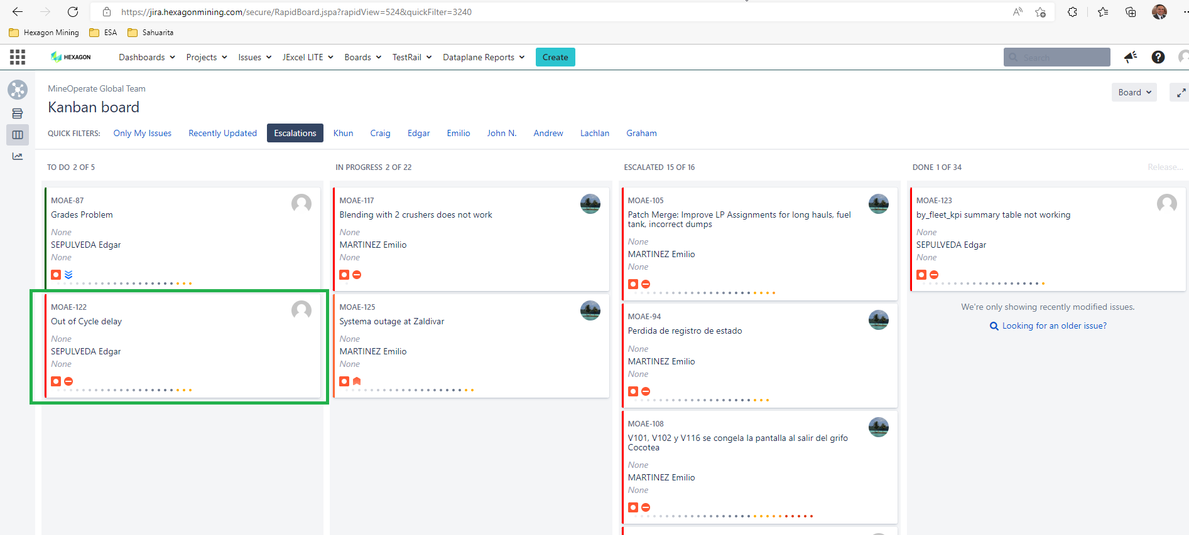
Support Process
MineOperate Global Team Kanban board

Slide 12
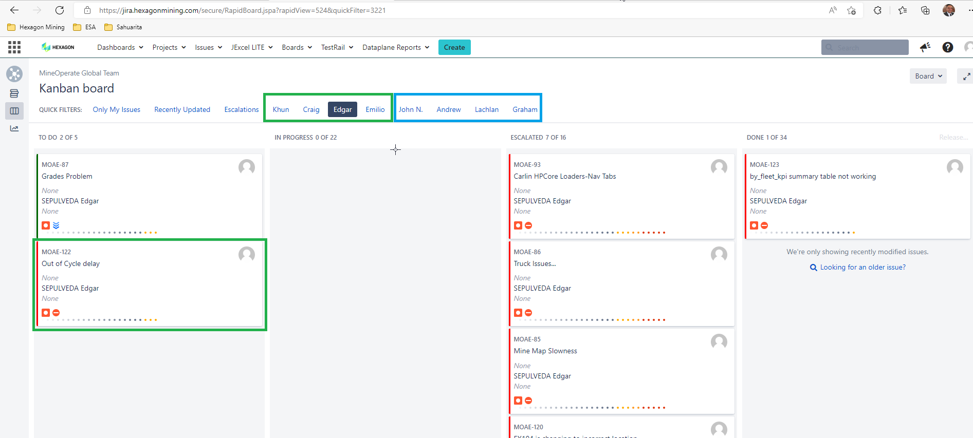
Support Process
MineOperate Global Team Kanban board

Slide 13
Support Process - Questions

Slide 14
Support Process - Answers to Questions

Slide 15

THANK
Y
O
U

